Slide 1
Using optimization to better understand leaf-to-whole plant acclimation
Nick Smith
Texas Tech University
nick.smith@ttu.edu; @nick_greg_smith

Slide 2
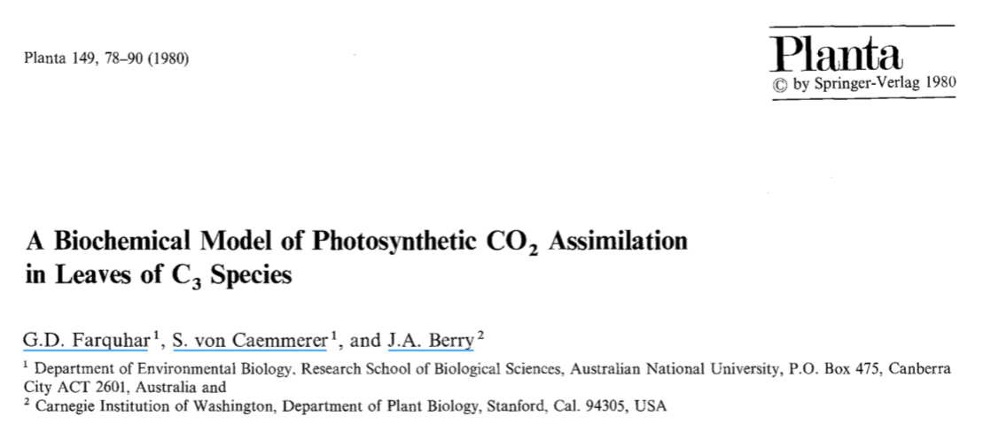
Theoretical models for photosynthesis exist
nick.smith@ttu.edu; @nick_greg_smith

Slide 3
And short-term responses are well known!
nick.smith@ttu.edu; @nick_greg_smith

Slide 4
Long-term responses can differ from short-term responses due to acclimation
nick.smith@ttu.edu; @nick_greg_smith

Slide 5
Long-term responses can differ from short-term responses due to acclimation
nick.smith@ttu.edu; @nick_greg_smith
Acclimated to high light
Acclimated to low light

Slide 6
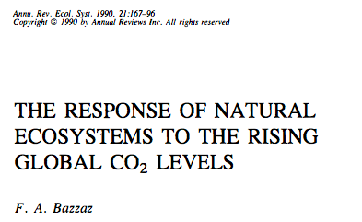
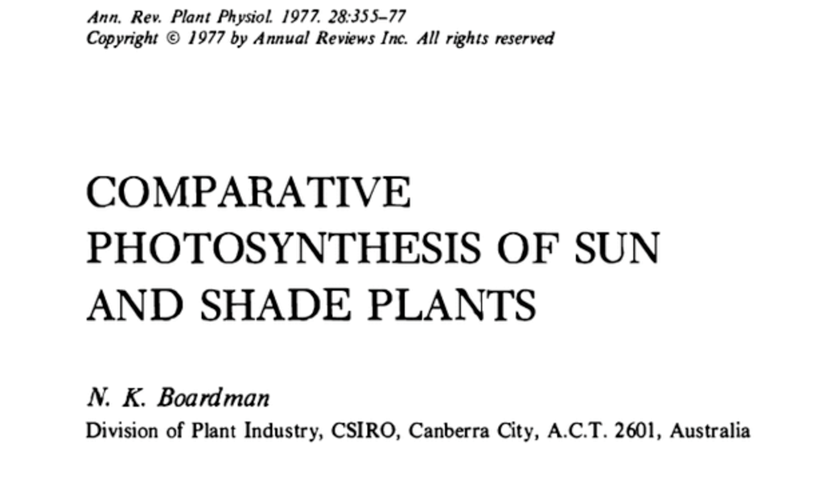
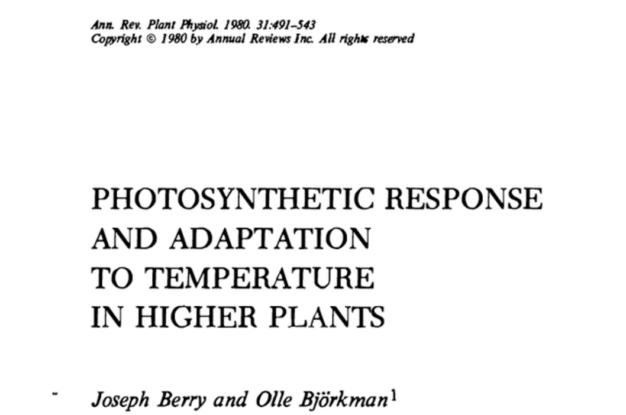
Acclimation is ubiquitous and well known…
nick.smith@ttu.edu; @nick_greg_smith
Temperature: Berry & Björkman (1980)
CO₂: Bazzaz (1990)
Light: Boardman (1977)

Slide 7
…and can impact carbon cycling and climate…
nick.smith@ttu.edu; @nick_greg_smith
Acclimation alters future temperature by >1°C
Smith et al. (2017) JAMES

Slide 8
…but the mechanisms underlying photosynthetic acclimation are not well known
nick.smith@ttu.edu; @nick_greg_smith

Slide 9
Solution: A testable, theoretical model!
nick.smith@ttu.edu; @nick_greg_smith

Slide 10
Least cost theory
nick.smith@ttu.edu; @nick_greg_smith
Maintain fastest rate of photosynthesis at the lowest cost (water and nutrient use)
Wright et al. (2003) American Naturalist

Slide 11
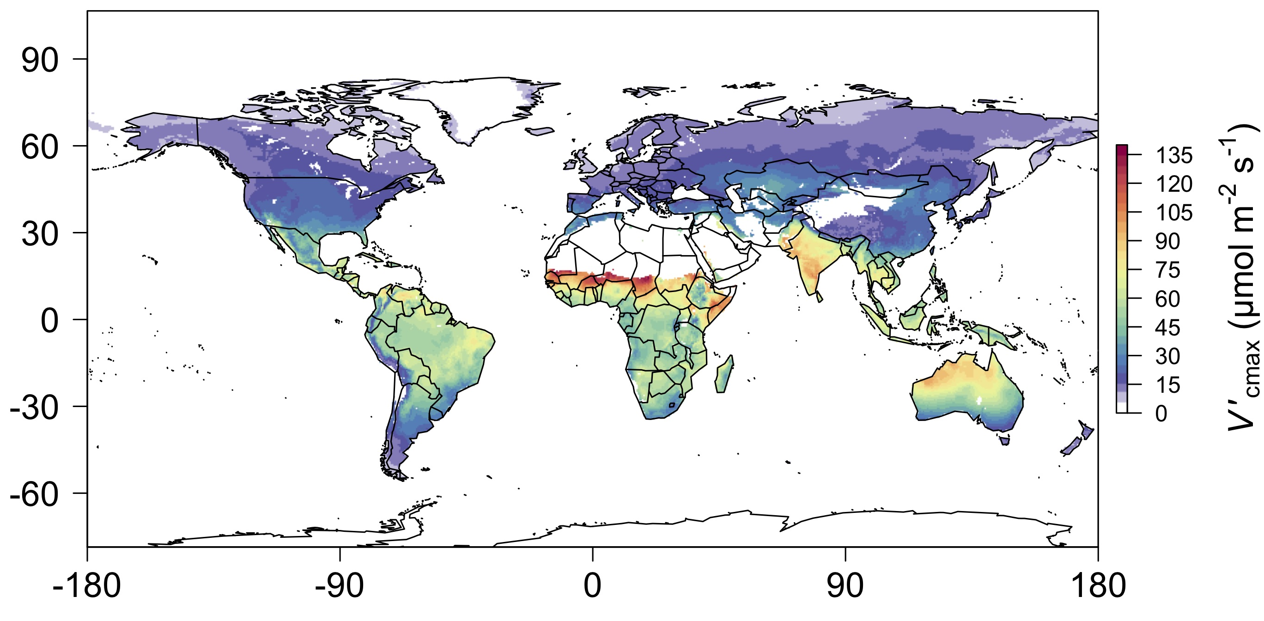
nick.smith@ttu.edu; @nick_greg_smith
We can predict optimal traits in different environments
Smith et al. (2019) Ecology Letters

Slide 12
Ok, great, but now what?
nick.smith@ttu.edu; @nick_greg_smith

Slide 13
Let’s tackle some big questions in plant ecophysiology!
nick.smith@ttu.edu; @nick_greg_smith

Slide 14
Question 1: Is photosynthesis optimized to the environment?
nick.smith@ttu.edu; @nick_greg_smith

Slide 15
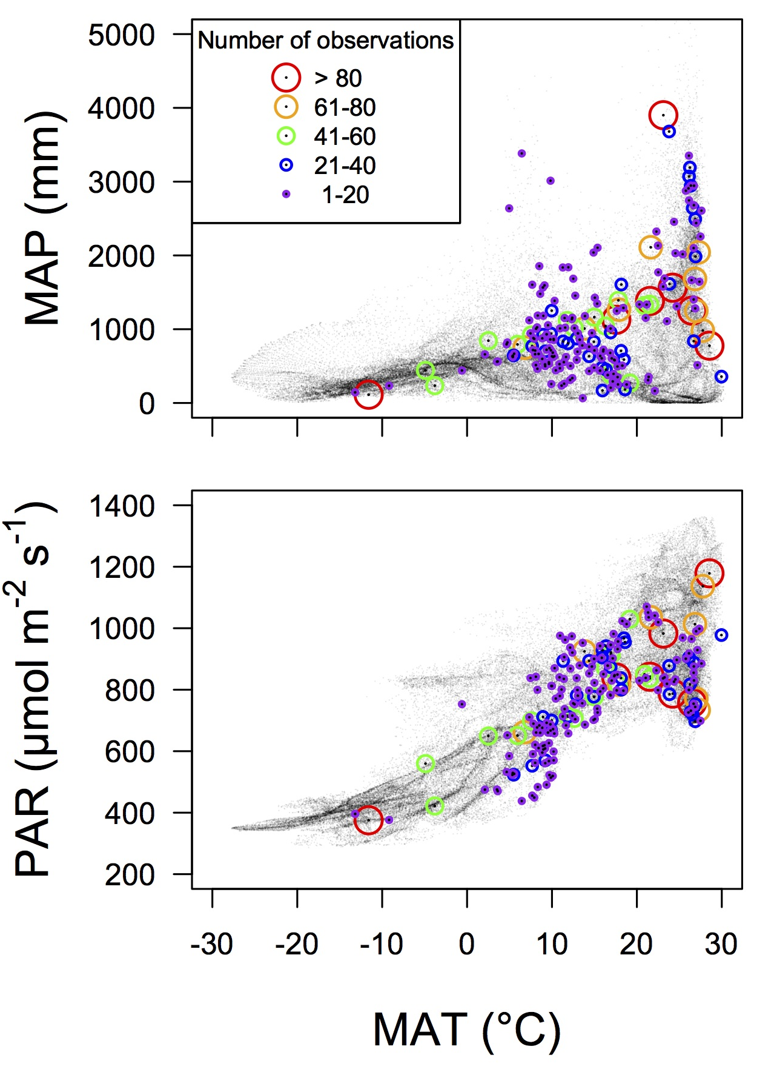
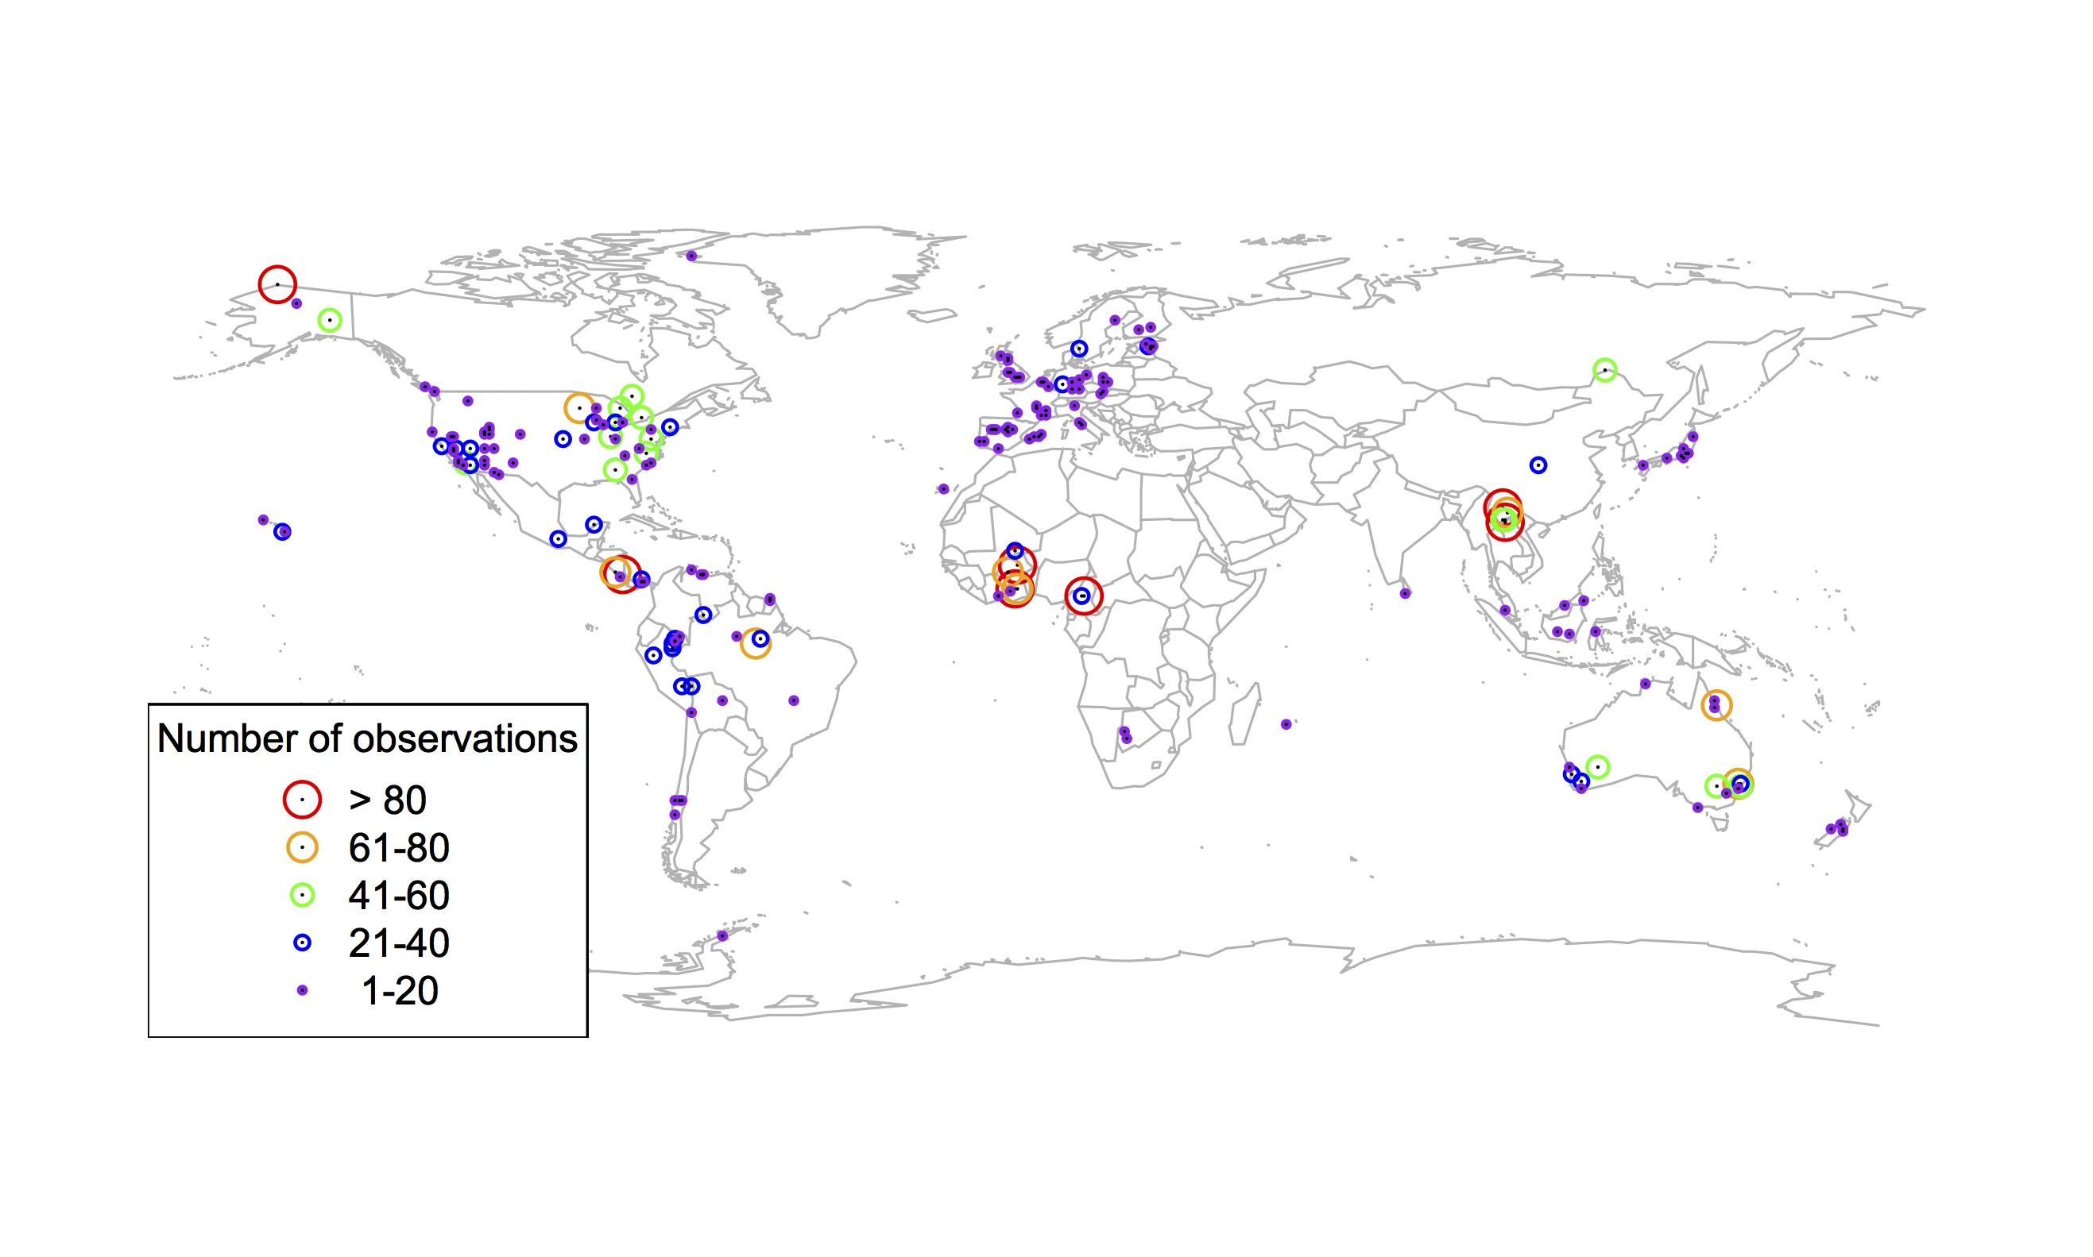
Global V_{cmax} dataset
nick.smith@ttu.edu; @nick_greg_smith
3,697 measurements
202 sites
> 600 genera
Smith et al. (2019) Ecology Letters

Slide 16
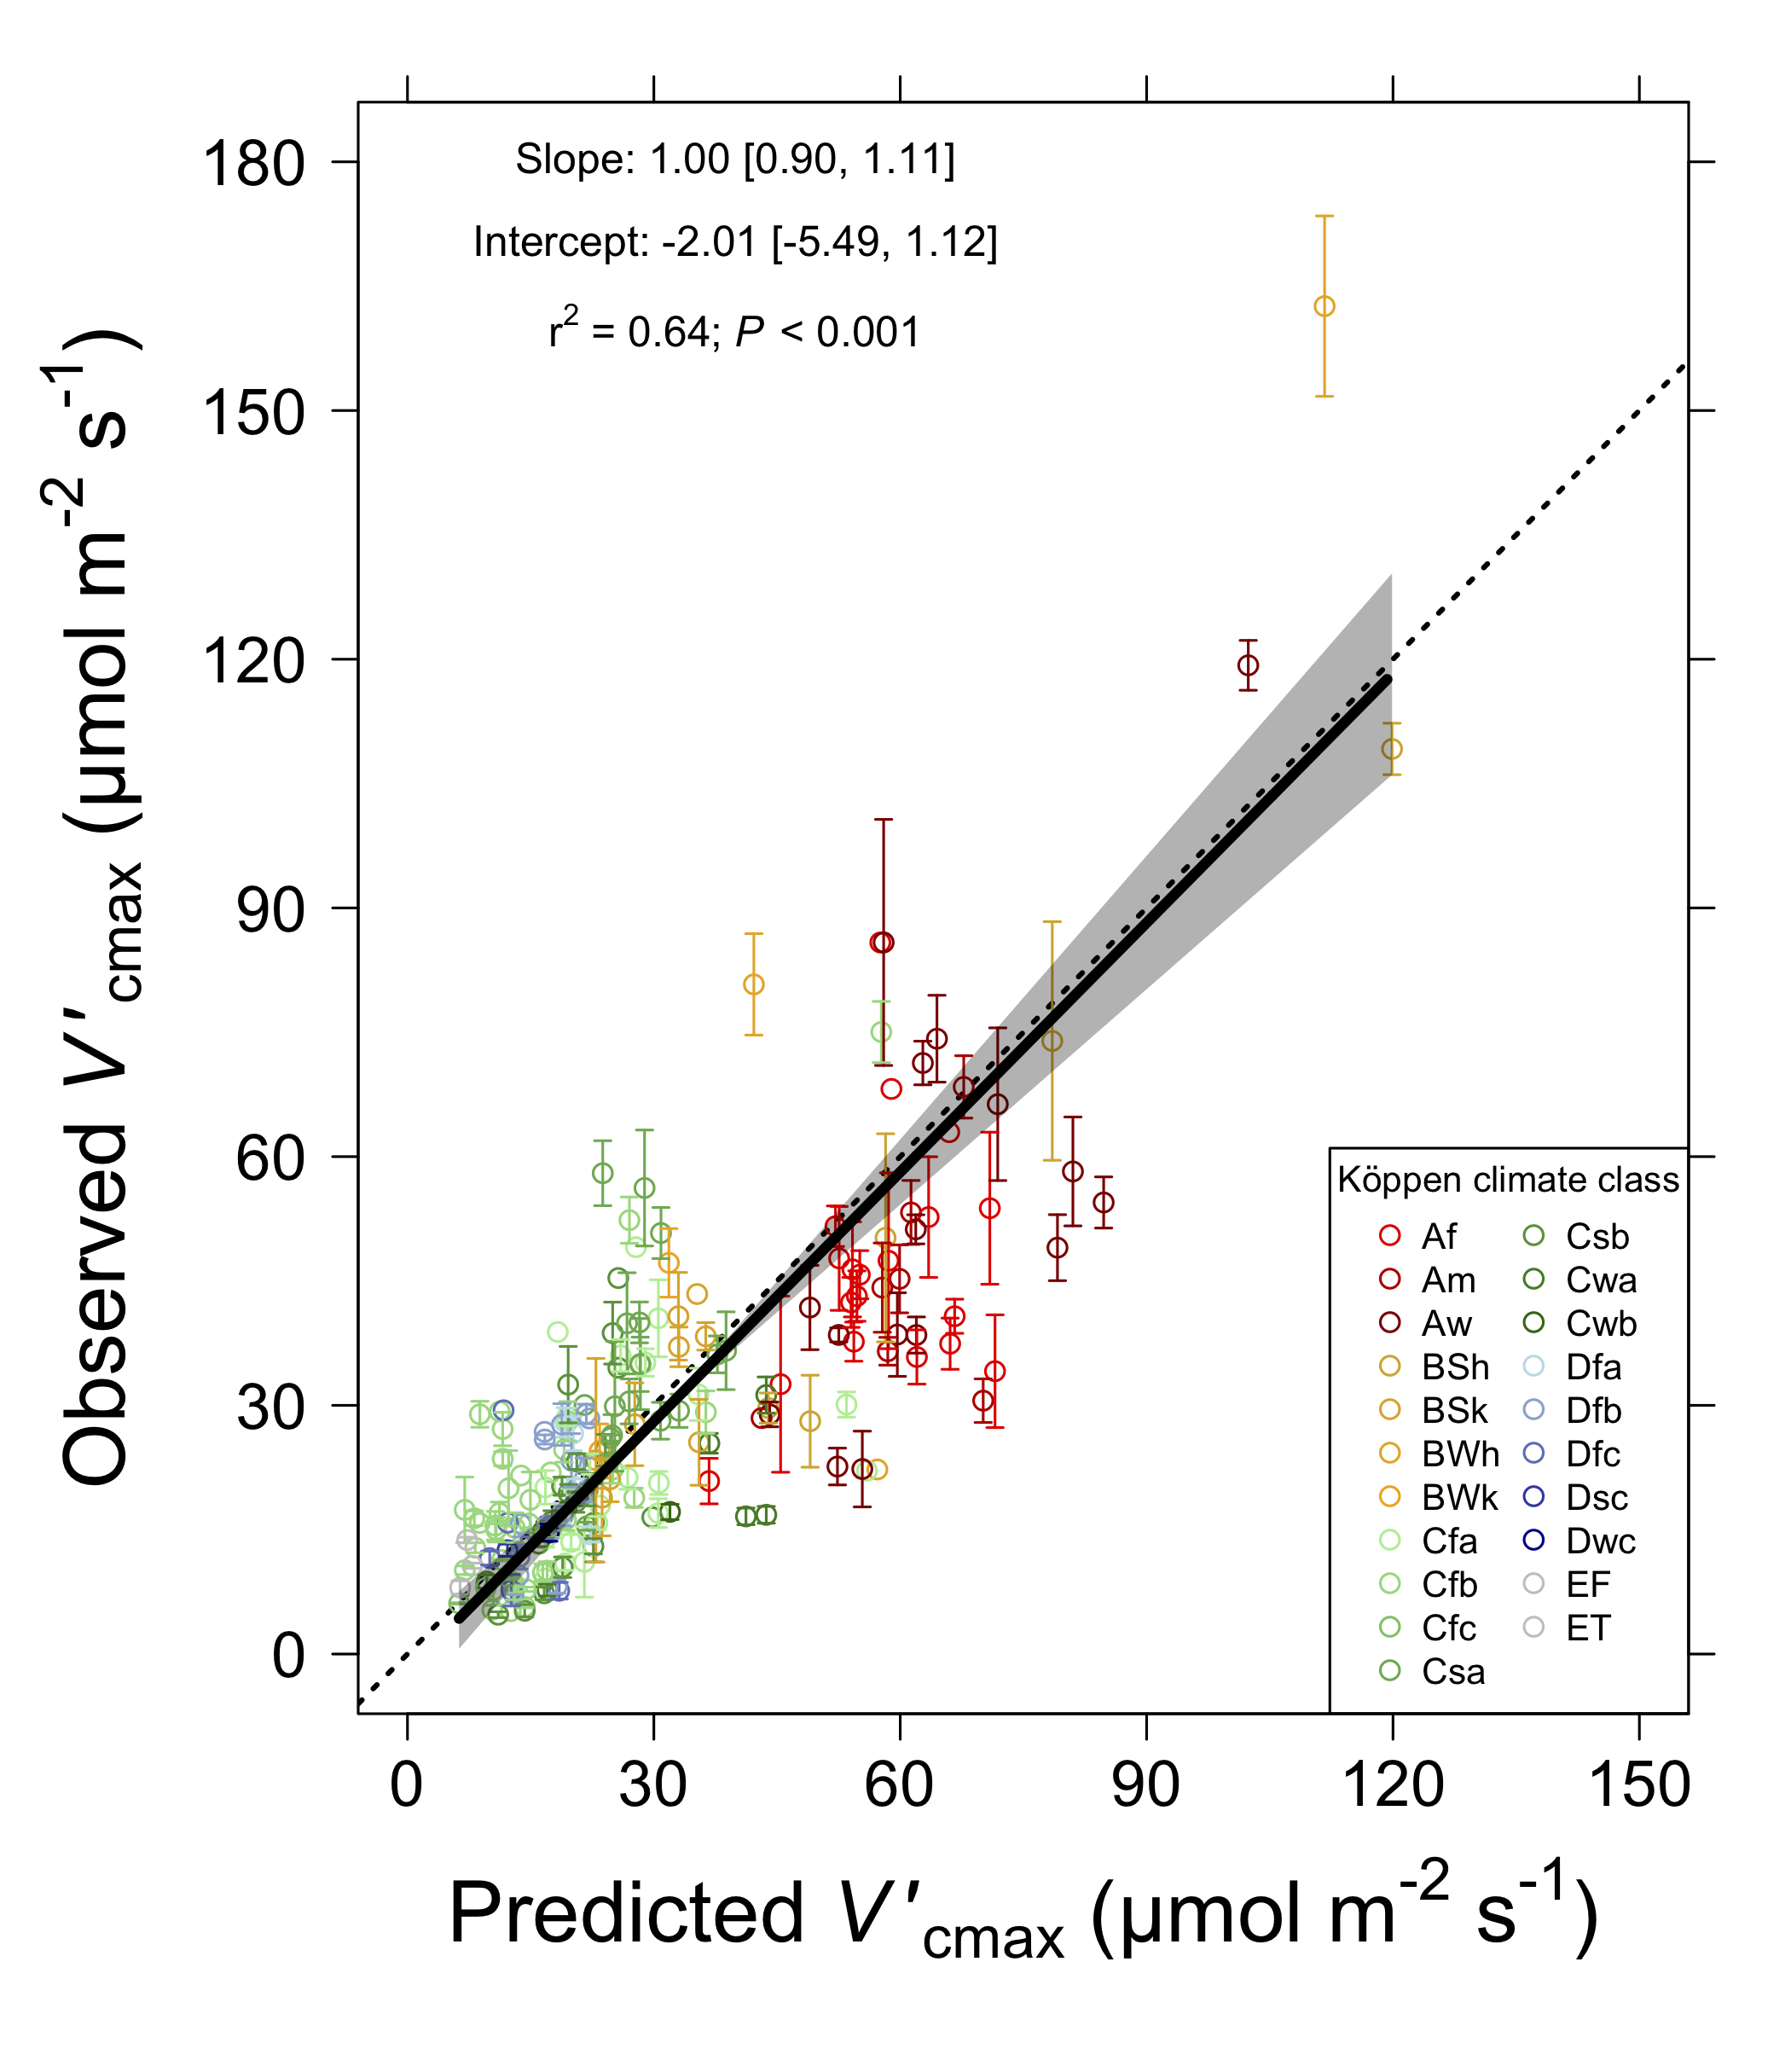
nick.smith@ttu.edu; @nick_greg_smith
Smith et al. (2019) Ecology Letters

Slide 17
Question 1: Is photosynthesis optimized to the environment? YES! Photosynthesis acclimates spatially as expected from optimization
nick.smith@ttu.edu; @nick_greg_smith

Slide 18

Question 2: Does photosynthesis respond to soil nutrients?
nick.smith@ttu.edu; @nick_greg_smith
Lizz Waring
TTU

Slide 19
From the least cost hypothesis…
nick.smith@ttu.edu; @nick_greg_smith
Added nutrients will not increase photosynthesis because light limitation will kick in

Slide 20
From the least cost hypothesis…
nick.smith@ttu.edu; @nick_greg_smith
Added nutrients will not increase photosynthesis because light limitation will kick in
Optimal response would be to increase leaf area

Slide 21
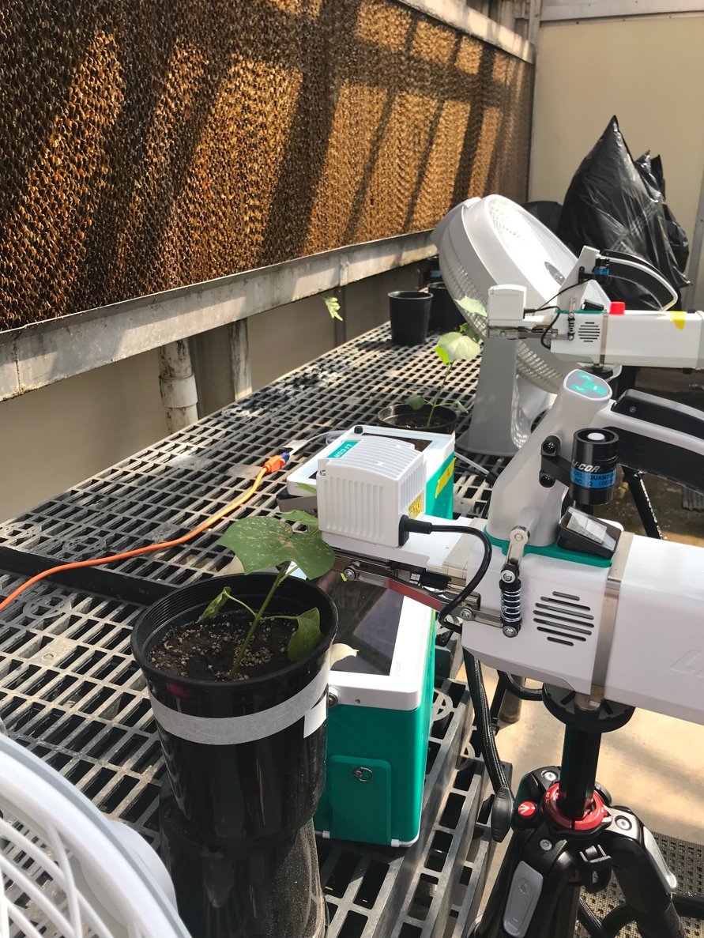
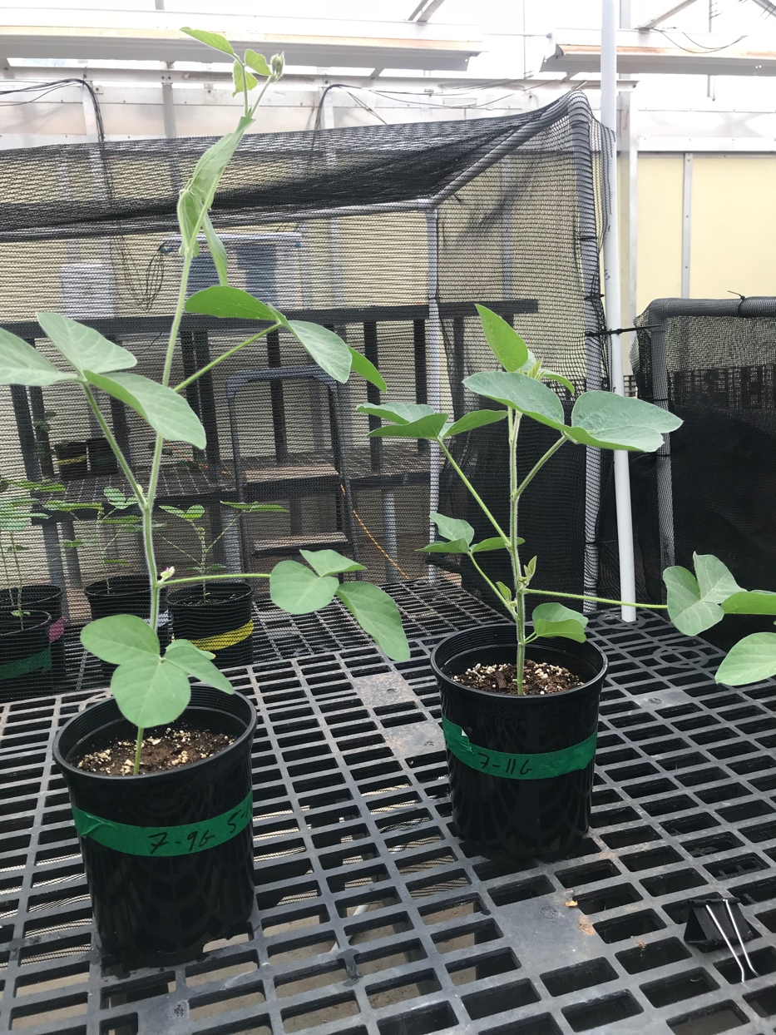
But let’s test it experimentally
nick.smith@ttu.edu; @nick_greg_smith

Slide 22
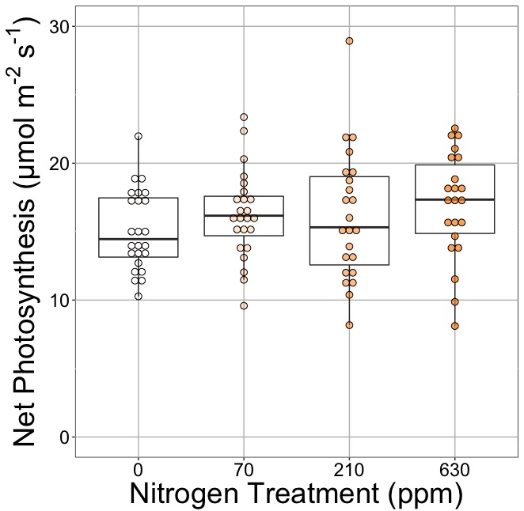
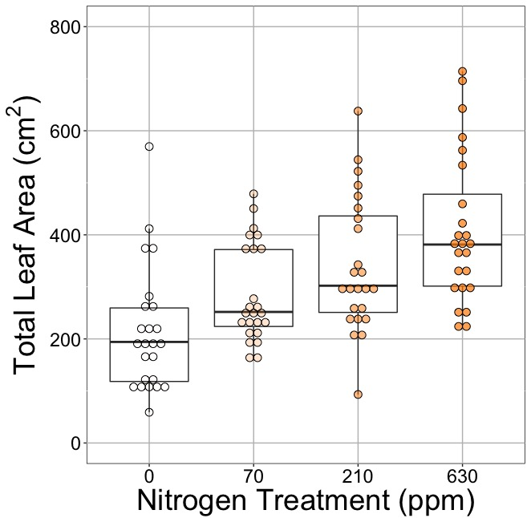
nick.smith@ttu.edu; @nick_greg_smith
Waring and Smith (in prep)

Slide 23
nick.smith@ttu.edu; @nick_greg_smith
No change (P = 0.42)
Waring and Smith (in prep)

Slide 24
Leaf area, but not photosynthesis increases with N addition
nick.smith@ttu.edu; @nick_greg_smith
No change (P = 0.42)
91% increase (P < 0.05)
Waring and Smith (in prep)

Slide 25
But do greenhouse experiments translate to the field?
nick.smith@ttu.edu; @nick_greg_smith

Slide 26
nick.smith@ttu.edu; @nick_greg_smith
Grassland soil nutrient addition network:
Leaf area index
Per-leaf-area nitrogen (photosynthetic proxy)

Slide 27
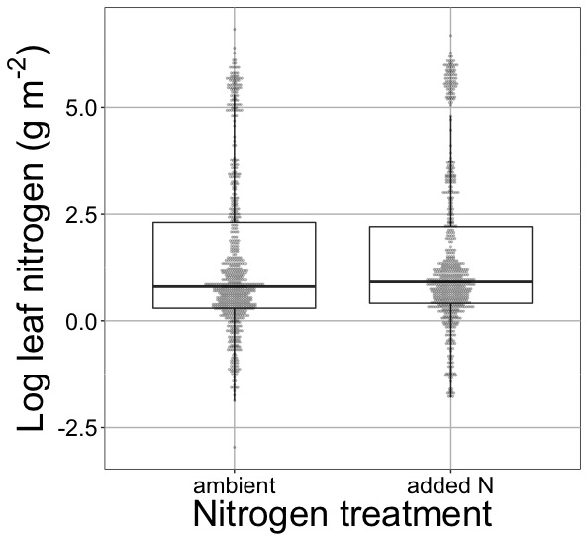
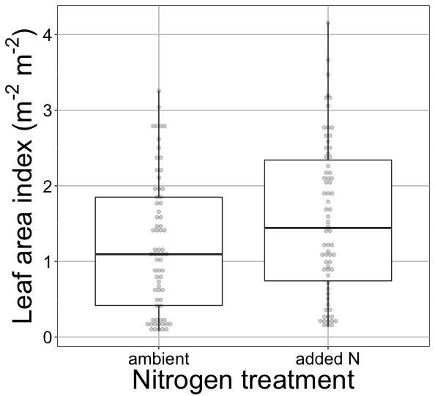
nick.smith@ttu.edu; @nick_greg_smith
Waring and Smith (in prep)

Slide 28
nick.smith@ttu.edu; @nick_greg_smith
No change (P > 0.05)
Waring and Smith (in prep)

Slide 29
Globally, N addition increases leaf area, not leaf N
nick.smith@ttu.edu; @nick_greg_smith
No change (P > 0.05)
41% increase (P < 0.05)
Waring and Smith (in prep)

Slide 30
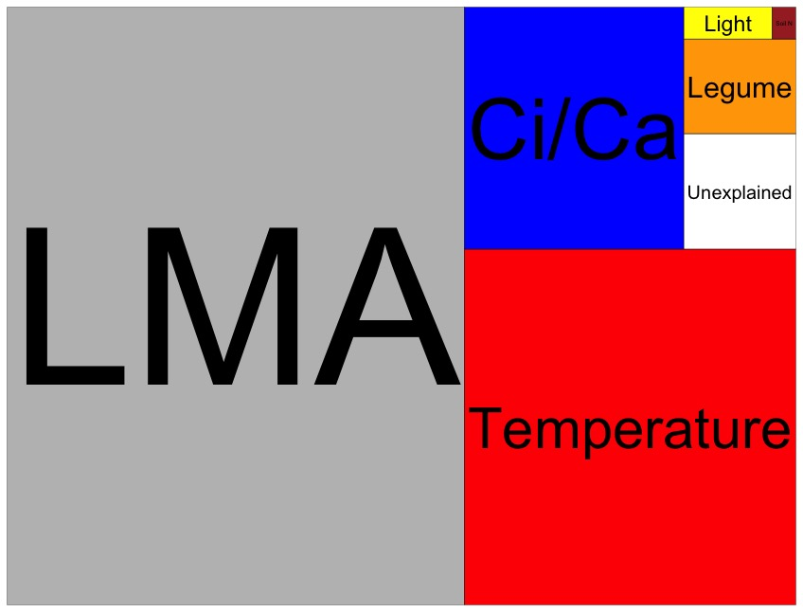
Globally, N addition has no impact on leaf N
nick.smith@ttu.edu; @nick_greg_smith
Each box is proportional to the variance in leaf N explained by each variable
Waring and Smith (in prep)

Slide 31
Question 2: Does photosynthesis respond to soil nutrients? No, plants respond to added nutrients by increasing leaf area, not photosynthesis
nick.smith@ttu.edu; @nick_greg_smith

Slide 32

Question 3: What does acclimation mean for future conditions?
nick.smith@ttu.edu; @nick_greg_smith
Qing Zhu (LBNL)
Bill Riley (LBNL)

Slide 33
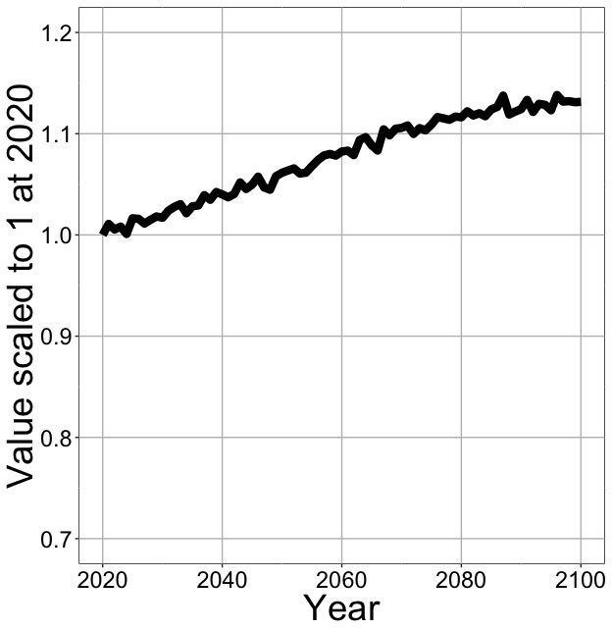
Higher CO₂ and increased temperatures increase future photosynthesis
nick.smith@ttu.edu; @nick_greg_smith
Net Photosynthesis
Smith et al. (in prep)

Slide 34
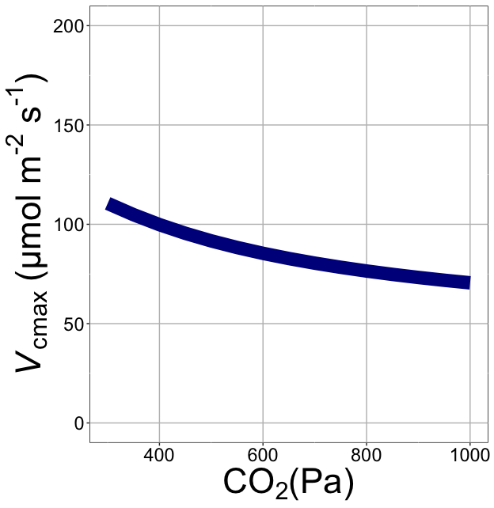
Downregulation under elevated CO₂ would reduce leaf nutrient demand!
nick.smith@ttu.edu; @nick_greg_smith
Smith et al. (2019)

Slide 35
Higher CO₂ and increased temperatures increase future photosynthesis
nick.smith@ttu.edu; @nick_greg_smith
Net Photosynthesis
Smith et al. (in prep)

Slide 36
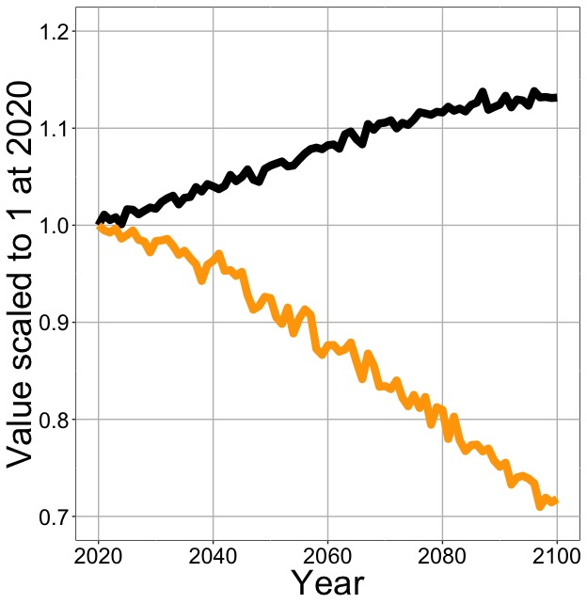
Higher CO₂ and increased temperatures increase future photosynthesis (at lower nutrient use)
nick.smith@ttu.edu; @nick_greg_smith
Net Photosynthesis
Leaf Nitrogen
Smith et al. (in prep)

Slide 37
Need to rethink nutrient limitation in models
“No limitation” simulation
“Nutrient limitation” simulations
Weider et al. (2015)

Slide 38
Question 3: What does acclimation mean for future conditions? Photosynthesis will increase and per-leaf-area nutrient use will decrease
nick.smith@ttu.edu; @nick_greg_smith

Slide 39

Question 4: When is C₄ photosynthesis an advantage over C₃ photosynthesis?
nick.smith@ttu.edu; @nick_greg_smith
Helen Scott
TTU

Slide 40
nick.smith@ttu.edu; @nick_greg_smith
Relative advantage of C₄ physiology
Scott and Smith (in prep)

Slide 41
nick.smith@ttu.edu; @nick_greg_smith
Relative advantage of C₄ physiology
Scott and Smith (in prep)

Slide 42
nick.smith@ttu.edu; @nick_greg_smith
Relative advantage of C₄ physiology
Scott and Smith (in prep)

Slide 43
nick.smith@ttu.edu; @nick_greg_smith
Relative advantage of C₄ physiology
Scott and Smith (in prep)

Slide 44
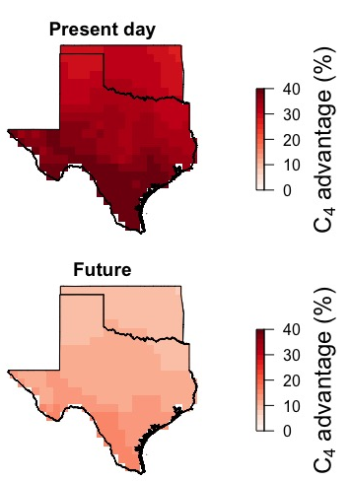
nick.smith@ttu.edu; @nick_greg_smith
Ansley et al. (in prep)

Slide 45
nick.smith@ttu.edu; @nick_greg_smith
Ansley et al. (in prep)

Slide 46
Question 4: When is C₄ photosynthesis an advantage over C₃ photosynthesis? C₄ is better in hot, dry, low CO₂ environments (maybe not future)
nick.smith@ttu.edu; @nick_greg_smith

Slide 47
Conclusion
Theory can be a useful null model for understanding the mechanisms underlying acclimation

Slide 48
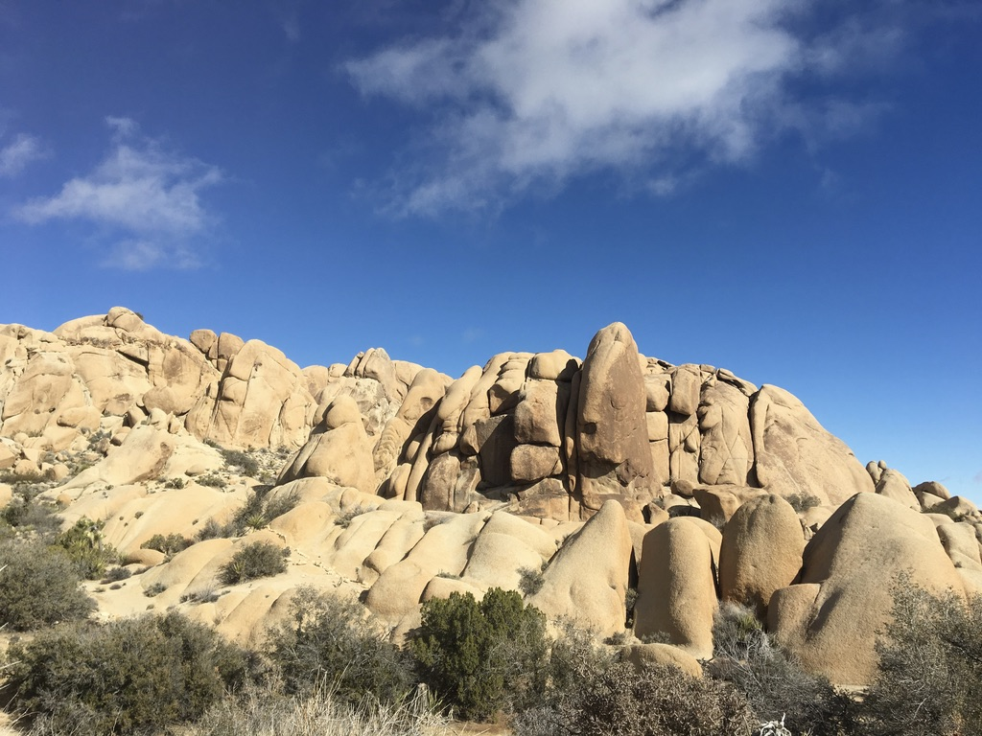
nick.smith@ttu.edu; @nick_greg_smith
Presentation available at:
www.github.com/SmithEcophysLab/agu_2019
Thanks!

